Slide 1
DC motors
Success Criteria
identify parts on DC motors and state their function and purpose
calculate force and torque on a motor
correctly determine direction of current, magnetic field and force

Slide 2
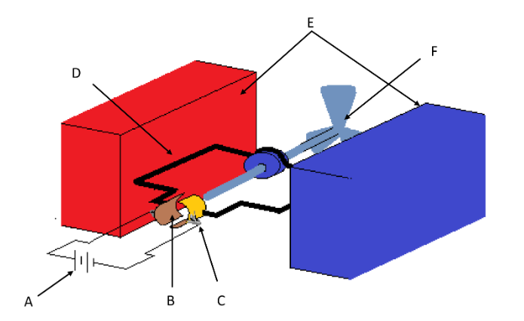
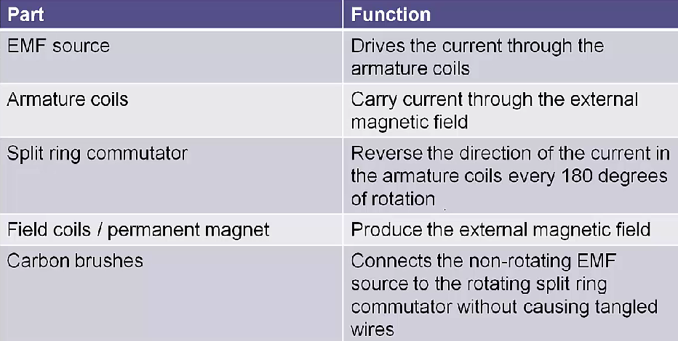
DC Motor Parts
Content Development
A
D
B
E
C
F Something that utilises the torque

Slide 3
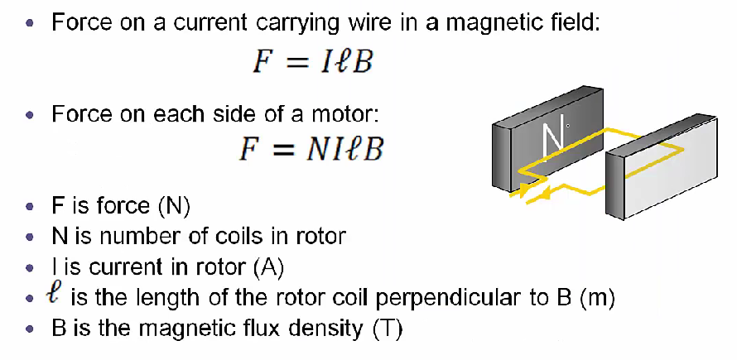
DC Motor Calculations
Content Development

Slide 4
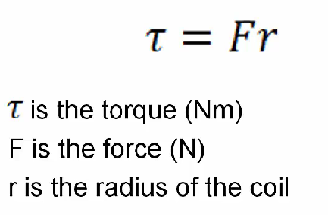
DC Motor Calculations
Content Development
Torque on one side of the coil
Total torque
τ_{t} = 2τ
= 2 F r
= 2 I l B r
τ_{t} = N I B A
A = 2* length*width

Slide 5
Homework
Questions on DC Motor worksheet
Notes:
https://ophysics.com/em7.html
https://ophysics.com/em8.html

